Slide 1
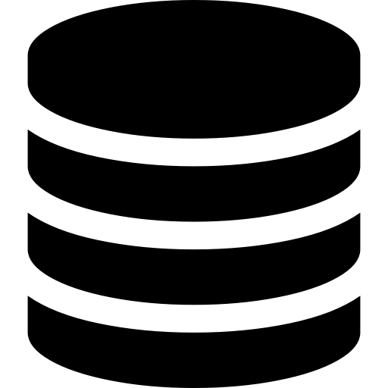


Development Technology
Database
Backend
Frontend
MongoDB
ExpressJS running on top of NodeJS
ReactJS
MERN Stack
Notes:
MERN framework Source: https://dev.to/theme_selection/best-web-development-stack-2jpe
Icons source: https://icons8.com/icon/WMvhDPZBJ9X2/backend-development

